Slide 1


The Future of Educational Gaming
Transforming Learning Through Play

Slide 2
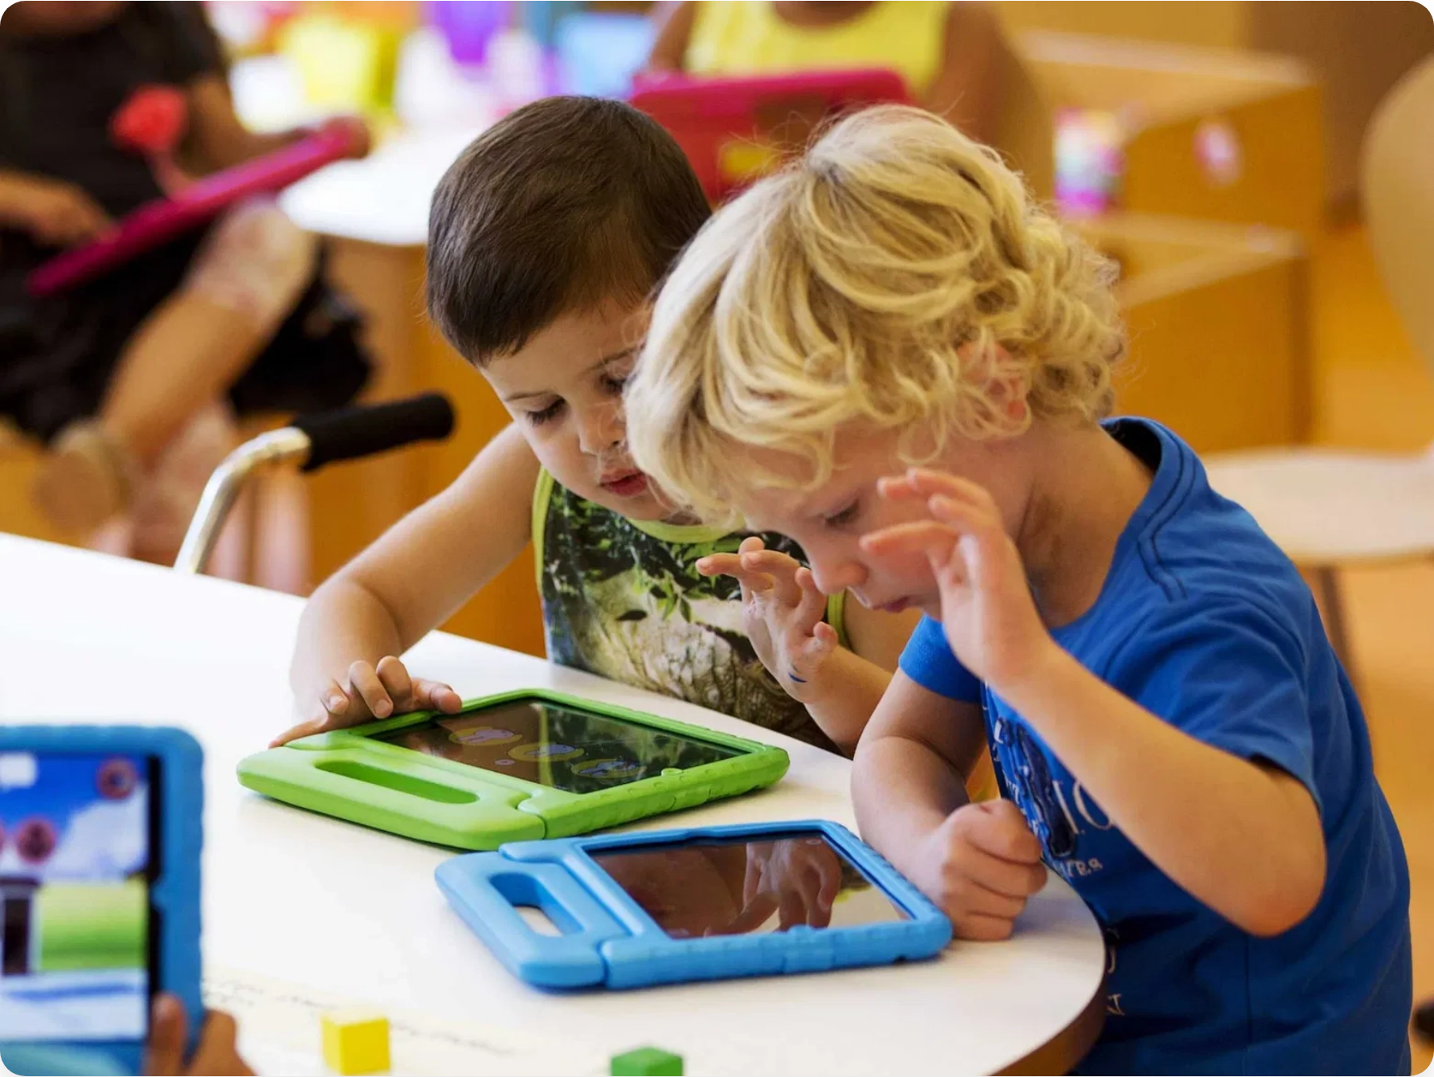
The Power of Play in Learning
Educational gaming is transforming modern teaching by blending play with purpose, creating immersive experiences that engage learners, sharpen critical thinking, and make complex ideas easier to grasp.
By 2030, the educational gaming market is projected to grow from $4.19B to $20.58B, reflecting a fundamental shift in how we approach learning.

Slide 3






Game Objectives & Core Functionalities
Game Objectives
Core Functionalities
Educational Focus:
Explore fields like history, physics, geography,
and science
User Interface & Experience
Knowledge Testing:
Test and enrich users' general knowledge
Intuitive navigation following layout concepts
through gameplay
Responsive design with reasonable loading times
Skill Development:
Target logic and general awareness through
challenges
User Experience:
Prioritize intuitive interface and responsive design
Content Management
Random questions from different categories using open APIs
Open APIs
Multiple-choice format with varied difficulty levels
Unity
C#
Figma
Visual Studio
UI Components
Game Mechanics
Progressive difficulty based on user performance
Comprehensive scoring system to track progress

Slide 4

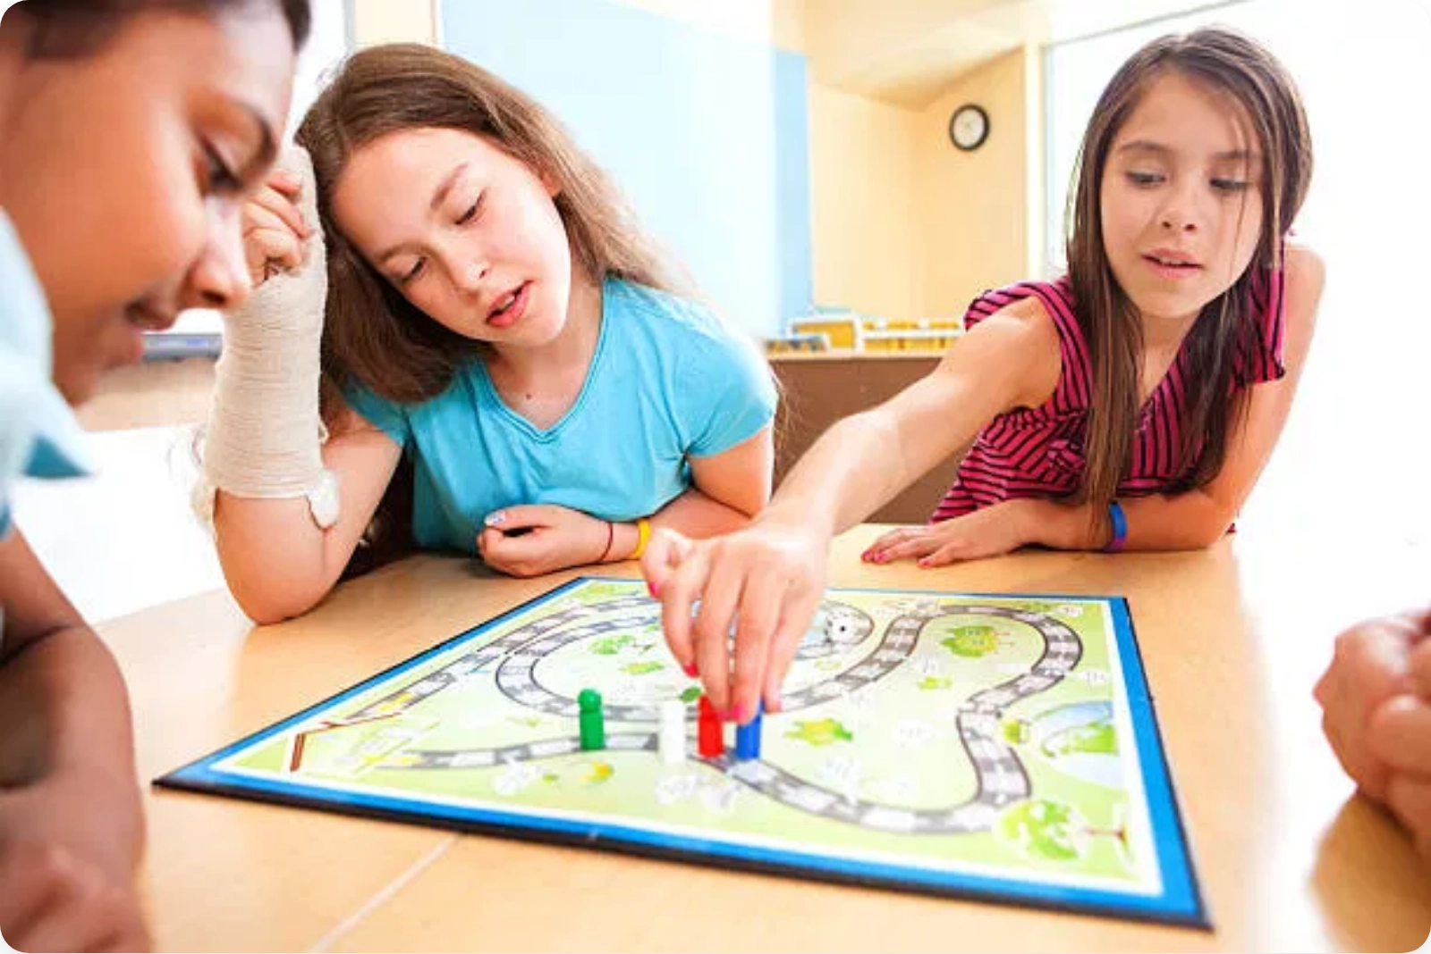






Benefits of Educational Gaming
Increased Motivation:
Taps into the "dopamine loop,"
providing chemical rewards for achievements
Enhanced Creativity:
Encourages innovative thinking
and unique problem-solving approaches
Future-Ready Skills:
Develops digital literacy, critical
thinking, and adaptability needed for 21st-century
careers
Educational games foster critical thinking, perseverance, creativity, and teamwork while making learning more engaging and effective.
Equity and Inclusion:
Provides multiple entry points
for diverse learners, allowing shy or struggling
students to shine
Cognitive Benefits:
Improves memory, attention, and
problem-solving skills through active engagement
"When students play with purpose, they learn with
Social Development:
Enhances collaboration,
passion."
communication, and healthy competition
— Educational Gaming Research, 2025

Slide 5




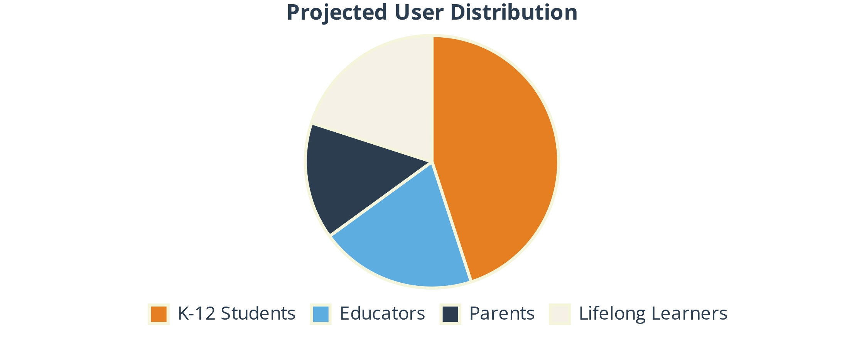
Targeted Users & Stakeholders
Primary User Segments
Indirect Stakeholders
Students (K-12)
Educators
Educational Institutions
Primary audience seeking engaging educational content through interactive gameplay.
Teachers looking for supplementary tools to enhance classroom instruction.
Why they matter:
Schools and universities may adopt the game as a learning
tool.
Impact:
Potential curriculum integration if proven effective.
Parents
Lifelong Learners
Seeking educational entertainment with learning value for children.
Adults interested in expanding knowledge through gamified experiences.
Parents & Guardians
Why they matter:
Provide guidance for younger users.
Interest:
Safety, age-appropriate content, educational value.
Content Creators & Educators
Why they matter:
May contribute questions and educational content.
Interest:
Accuracy and alignment with educational standards.

Slide 6

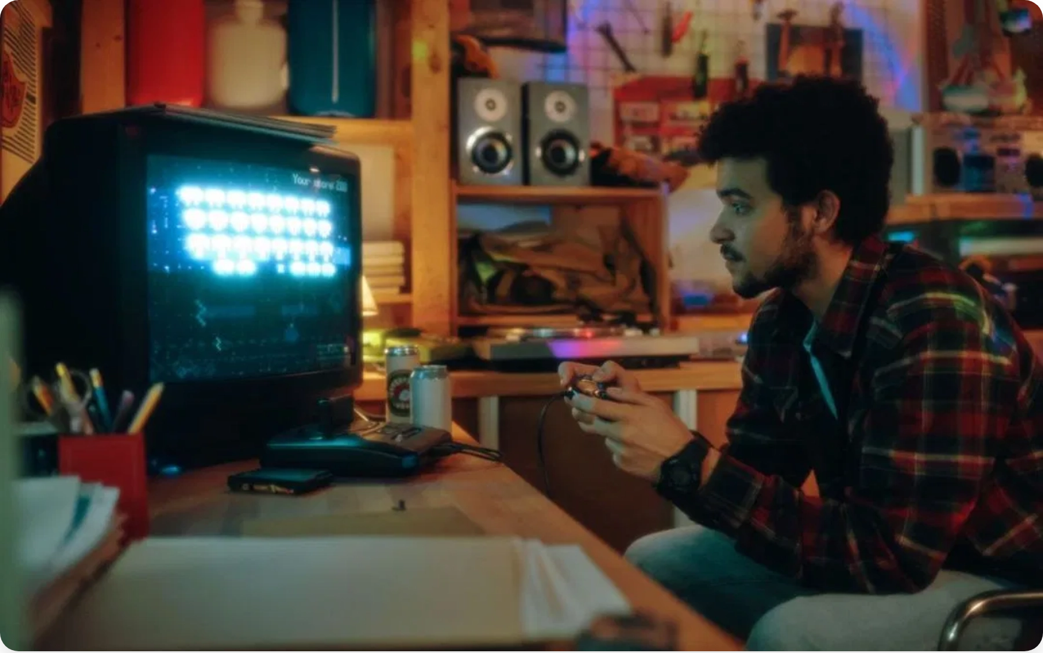
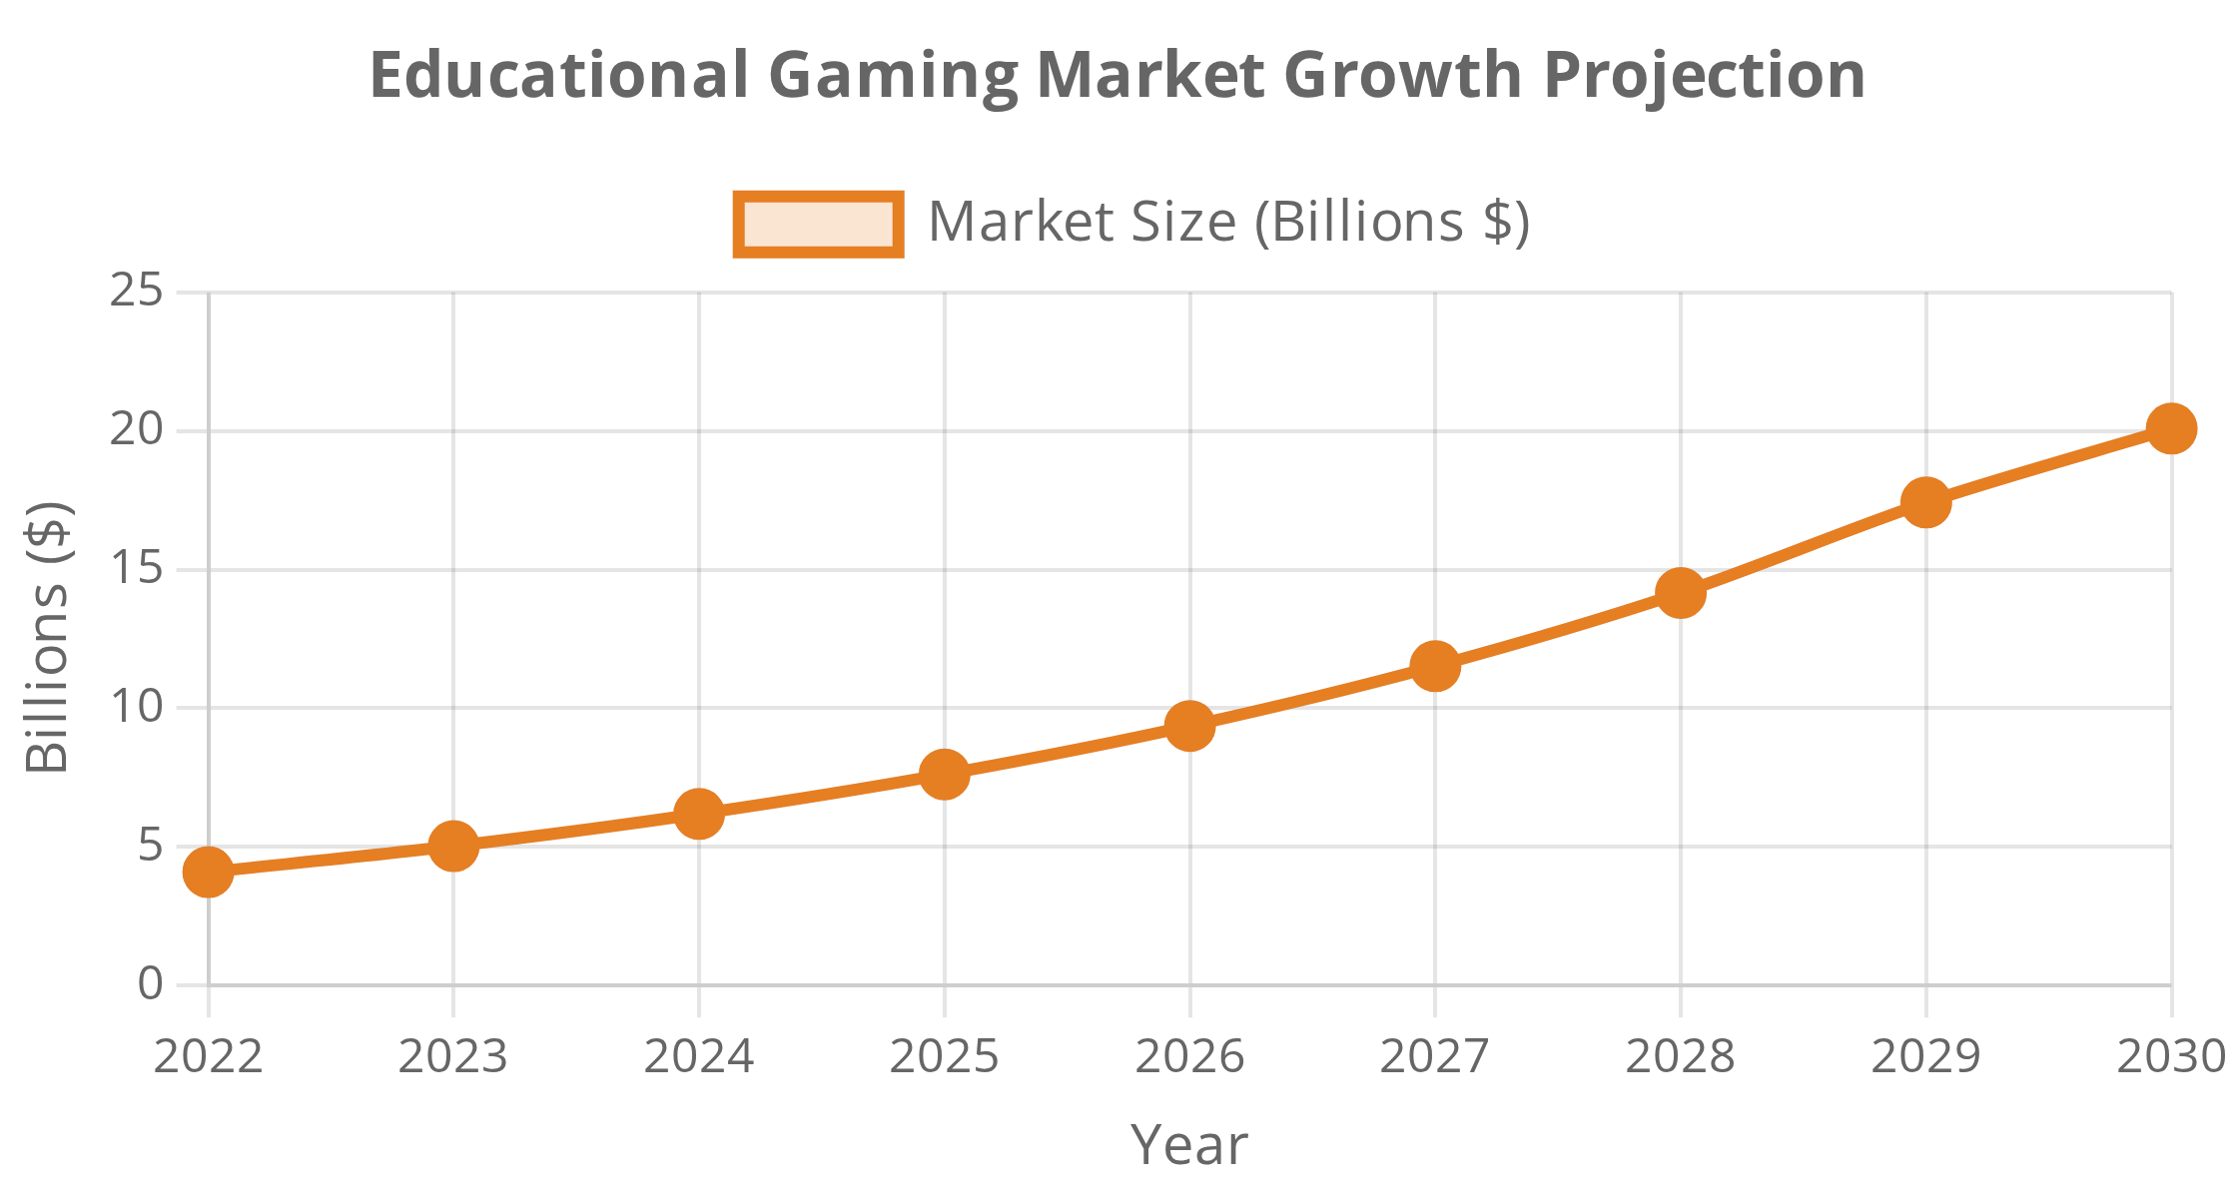


Market Growth & Trends
Market Analysis
Educational Gaming Market Growth
The educational gaming market is experiencing explosive growth, projected to increase from $4.19B in 2022 to $20.58B by 2030, representing a 23% CAGR (Compound Annual Growth Rate).
Emerging Trends in Educational Gaming
Integration of AI for personalized learning experiences
Expansion of UGC (User-Generated Content) platforms like Roblox and Minecraft in education
Increased adoption of VR/AR technologies for immersive learning
Growth of multifaceted educational platforms with thousands of activities
Dual-market approach targeting both consumers and educational institutions
Platform
Educational Focus
Minecraft Education
Curriculum-focused with 600+ premade lessons
Roblox
Accessible coding and creative environment
Fortnite (UEFN)
Expanding educational potential through Creative Mode

Slide 7








Live Demo & Q&A
Live Demo Walkthrough
Anticipated Q&A
1
Game Launch & Category Selection
How does the game ensure educational value?
Demonstration of the intuitive user interface and category selection process from the main menu.
The game combines engaging gameplay with curriculum-aligned content.
2
Question Presentation
Multiple-choice questions with clean layout and responsive design.
3
Scoring & Feedback System
What makes this different from other trivia games?
Demonstration of the scoring mechanism and educational feedback provided after answers.
My focus is on educational outcomes, adaptive difficulty levels, and comprehensive progress tracking creates a more purposeful learning experience than standard trivia games.
4
Progress Tracking
Overview of how user progress is tracked and displayed throughout the game.
How will you expand the game in future updates?
Technical Requirements
Future updates will include AI-tailored difficulty levels, expanded categories, accessibility features, and potentially an AI chatbot for providing deeper insights into topics.
System:
Latest version of Visual Studio 2022, Unity
Development:
C#, Unity UI components, XML
API:
Open Trivia DB API for question fetching
How do you ensure content accuracy?
Note: The live demo will showcase the core functionalities implemented in Week 3 of the development cycle.
I use verified API sources and implement a review process for all educational content. The system also allows for content updates as educational standards evolve.

Slide 8



Play With Purpose
Educational gaming is a pedagogical revolution that transforms classrooms into places of curiosity, challenge, and joy while emphasizing cognitive growth and general awareness.
Engagement & Motivation:
Games tap into the dopamine loop,
Implementation Strategy (From Trivia Project)
providing chemical rewards that enhance learning retention.
Week 1:
Research on educational gaming methods and technologies
Future-Ready Skills:
Educational games develop critical thinking,
Week 2:
Design wireframes and prototypes for intuitive user interface
collaboration, and digital literacy needed for 21st-century careers.
Week 3:
Implementation with focus on requirements and user experience
Week 4:
Testing and evaluation for continuous improvement
Market Growth:
The educational gaming market is projected to grow
from $4.19B to $20.58B by 2030.
MoSCoW Prioritization
Evolving Role:
Teachers become facilitators, mentors, and designers
Must Have:
Multiple-choice questions, levels, categories, progress tracking
of learning experiences.
Should Have:
Tailored feedback, educational explanations
"When students play with purpose, they learn with passion. Educational gaming isn't a passing trend—it's the future of learning."
— Educational Gaming Research, 2025

Slide 9



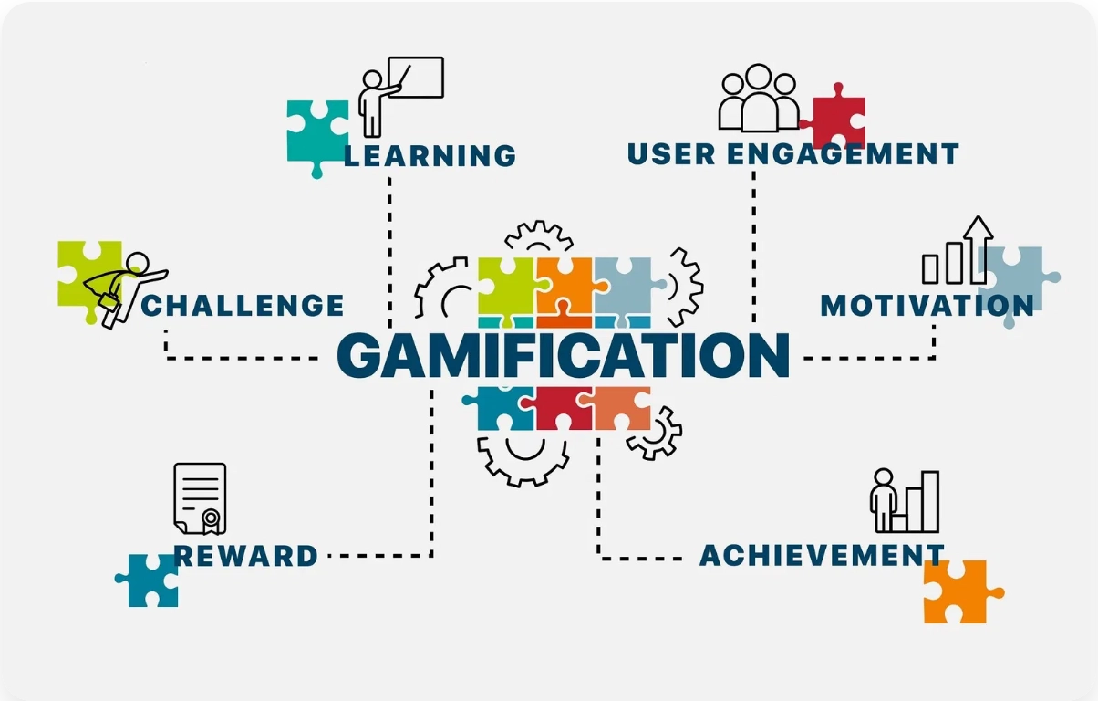
Thank you for your attention!
Contact Information
Details
Key Takeaways
Email
simeonmarkov777@gmail.com
Educational games blend play with purpose for deeper learning
The market is projected to grow to $20.58B by 2030
@Simeon31
Games develop critical thinking, creativity, and future-ready skills
GitHub
Platforms like Minecraft, Roblox, and others are leading innovation

